Slide 1
E-Commerce Sales
Data Analytics
Data Cleaning • EDA • Visualization • Power BI Dashboard
Final Data Analytics Project
Presented by: Mayur Rajput
InternNova Internship | Data Analytics
Final Week Project Presentation
E-Commerce Sales Data Analytics

Slide 2
Problem Statement
E-commerce businesses generate large amounts of sales data that can be difficult to analyze manually.
Raw data may contain missing values and duplicate records that affect analysis.
A clear analytical dashboard is required to understand sales, profit, regions, categories, and customer segments.
The project converts raw sales data into useful visual insights for better business decisions.
E-Commerce Sales Data Analytics

Slide 3
Project Objectives
Clean and prepare the E-Commerce Sales dataset.
Perform Exploratory Data Analysis (EDA) using Python.
Identify sales and profit patterns across categories and regions.
Create five meaningful data visualizations.
Develop an interactive Power BI dashboard with KPI cards and slicers.
Generate business insights and practical recommendations.
E-Commerce Sales Data Analytics

Slide 4
Dataset & Data Preparation
Dataset: E-Commerce Sales Data
Main fields: Order ID, Order Date, Region, Category, Customer Segment, Payment Method, Units Sold, Unit Price, Discount, Sales, Profit.
Duplicate records were removed during data cleaning.
Missing Customer Segment values were handled using a suitable replacement.
Order Date was converted into a proper date format for time-based analysis.
The cleaned dataset was used for Python analysis and the Power BI dashboard.
E-Commerce Sales Data Analytics

Slide 5
Exploratory Data Analysis
Category-wise sales were analyzed to identify high-performing product categories.
Region-wise sales were compared to understand geographic performance.
Customer segments were analyzed to understand their contribution to sales.
Profit by category was examined to identify profitable product groups.
Correlation analysis was performed on numerical variables such as Units Sold, Unit Price, Discount, Sales, and Profit.
E-Commerce Sales Data Analytics

Slide 6
Data Visualizations
1. Total Sales by Category
2. Total Sales by Region
3. Monthly Sales Trend
4. Total Profit by Category
5. Sales vs Profit
E-Commerce Sales Data Analytics

Slide 7
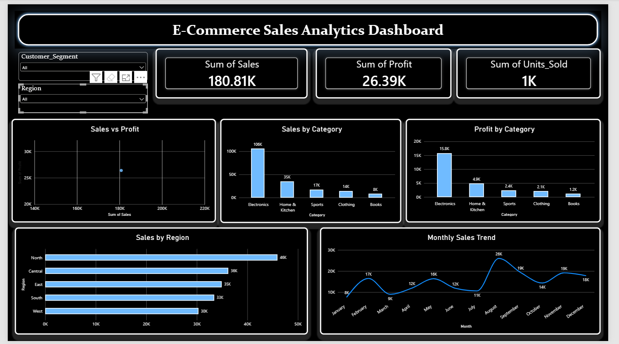
Power BI Dashboard
E-Commerce Sales Data Analytics

Slide 8
Dashboard Components
KPI Cards: Total Sales, Total Profit, and Total Units Sold.
Charts: Sales by Category, Sales by Region, Monthly Sales Trend, Profit by Category, and Sales vs Profit.
Slicers: Region and Customer Segment.
The dashboard provides an interactive and user-friendly view of business performance.
Users can apply slicers to explore selected regions and customer segments.
E-Commerce Sales Data Analytics

Slide 9
Business Insights & Recommendations
Electronics is the strongest category in the dashboard for both sales and profit.
North region records the highest sales among the shown regions.
Monthly sales fluctuate throughout the year, with a noticeable peak in August.
Category-wise profit analysis helps identify products contributing more to profitability.
Recommendations: focus marketing and inventory on strong categories and improve promotions in weaker regions or segments.
E-Commerce Sales Data Analytics

Slide 10
Conclusion
The project successfully transformed raw E-Commerce Sales data into meaningful analytical insights.
Python was used for data cleaning, EDA, analysis, and visualization.
Power BI was used to build an interactive dashboard with KPIs, charts, and slicers.
The final analysis helps understand sales performance, profitability, regional trends, and customer segments.
The project demonstrates an end-to-end Data Analytics workflow.
Thank You

